Slide 1


Mixing Paradigms
NDC Porto 2022
using the latest C# language features
Zoran Horvat
Principal consultant at Coding Helmet
http://codinghelmet.com
zh@codinghelmet.com
zoranh75

Slide 2
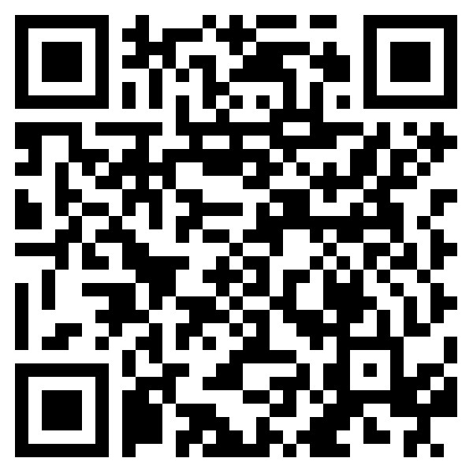
Source Code
https://github.com/zoran-horvat/ conf-2022-04-ndc-porto

